Slide 1
CS 1150 – Lab #2 – Exploring Number Systems
TA – Sanjaya Wijeratne
E-mail – wijeratne.2@wright.edu
Web Page - http://knoesis.org/researchers/sanjaya/

Slide 2
TA Labs, Office Hours Laboratory Polices
Lab Hours
2:30 PM - 4:20 PM, Monday and Friday at Room 320 - Oelman Hall
TA Office Hours
4:40 PM - 5:40 PM, Monday and Friday at Room 316 - Russ Engineer Center
By appointment – Please email to wijeratne.2@wright.edu
Refer to CS 1150 Course Syllabus for Class and Laboratory Policies
Zero tolerance policy for Academic Misconduct – All parties will get 0% marks

Slide 3
Lab # 2 Overview
Experiment with Number Systems
Binary to Decimal Conversion
Decimal to Binary Conversion
Practice binary addition and converting between bases
Base 5 to Decimal
Lab #2 Due Date - Sep 15, 2013 11:55 PM

Slide 4
How to Submit Lab # 2
Hard copy (Preferred)
When you complete, hand it over to me
Pilot
Go to Pilot Course Page and Use Dropbox Submission Link to upload your files

Slide 5
Setting up Online Account
Go online to http://www.JBLearning.com/accesscode/ to redeem this access code for a personal account on JBLearning.com and access to the course.
On that page, paste in the ten digit access code and complete the requested personal information, following the online instructions.
When finished, a new account will be established with a personalized email address and password, allowing you access to the course. The 10 digit access code will no longer be needed.
From this point, simply visit http://www.JBLearning.com/login/ to log in as a "returning user" with the personalized email address and the password chosen.

Slide 6
Lab #2 Question 1
Use Binary Conversion Chart (Based on Positional Notation)
Example – Convert Binary Number 11101101 to Decimal
1 | 1 | 1 | 0 | 1 | 1 | 0 | 1
128 | 64 | 32 | 0 | 8 | 4 | 0 | 1
237
Source – CS 1150 Slides for Binary Values and Number Systems by Karen Mayer

Slide 7
Lab #2 Question 4
While (the quotient is not zero) {
Divide the decimal number by the new base
Make the remainder the next digit to the left in the answer
Replace the original decimal number with the quotient
}
Source – CS 1150 Slides for Binary Values and Number Systems by Karen Mayer

Slide 8
Lab #2 Question 4 Example
Source – http://www.wikihow.com/Convert-from-Decimal-to-Binary

Slide 9
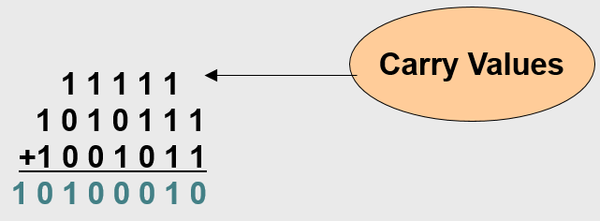
Lab # 2 Question 7
1 + 1 in Binary is 0 with a Carry
Source – CS 1150 Slides for Binary Values and Number Systems by Karen Mayer

Slide 10
Lab #2 Question 2, 3, 5, and 6

Slide 11
Lab #2 Question 2, 3, 5 and 6

Slide 12
Lab #2 Question 8 and 9

Slide 13
Lab # 2 Question 9 Hint

Slide 14
Questions ?
If you have questions, please raise your hand, Colin or myself will come to help you

